Slide 1
CHE412 Process Dynamics and Control
BSc (Engg) Chemical Engineering (7th Semester)
Dr Waheed Afzal
Associate Professor of Chemical Engineering wa.icet@pu.edu.pk
Institute of Chemical Engineering and Technology
University of the Punjab, Lahore

Slide 2
Text/ Reference Books
George Stephanopoulos. Chemical process control. Englewood Cliffs, New Jersey: Prentice-Hall, 1984
Donald R. Coughanowr and Steven E. LeBlanc. Process Systems Analysis and Control. McGraw-Hill Science/Engineering/Math, 2008
William L Luyben. Process modeling, simulation and control for chemical engineers. 2nd Edition, McGraw-Hill Higher Education, 1996
Don Green and Robert Perry. Perry's Chemical Engineers' Handbook, Eighth Edition McGraw-Hill, New York, 2007
Dale E. Seborg, Thomas F. Edgar, and Duncan A. Mellichamp. Process dynamics & control. 2nd Edition, Wiley. com, 2004.
Lecture Notes/ Handouts

Slide 3
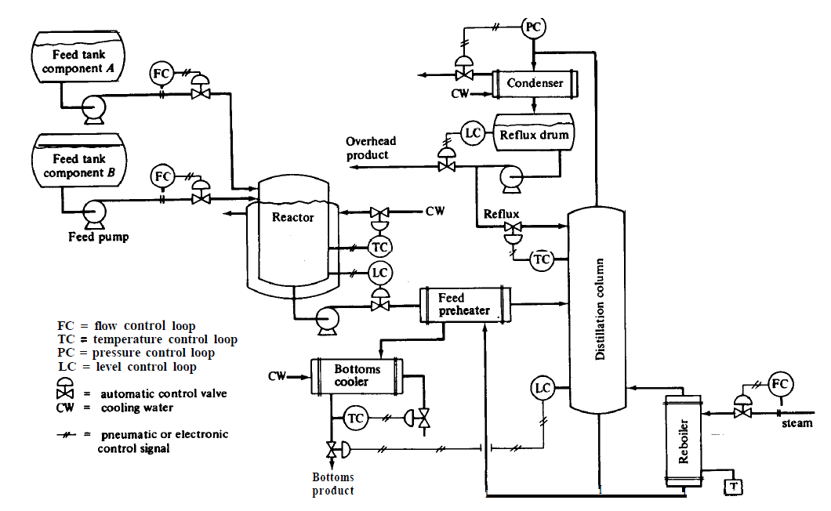
Place of Process Control in a typical Chemical Plant
Luyben (1996)
Notes:
A chemical plant consists of numerous processing units integrated in a logical way with an over all objective of producing desired products from raw materials in most economic way.

Slide 4
Need of a Control
Safety:
Equipment and Personnel
Production Specifications:
Quality and Quantity
Environmental Regulations:
Effluents
Operational Constraints:
Distillation columns (flooding, weeping); Tanks (overflow, drying), Catalytic reactor (maximum temperature, pressure)
Economics:
Minimum operating cost, maximum profits

Slide 5
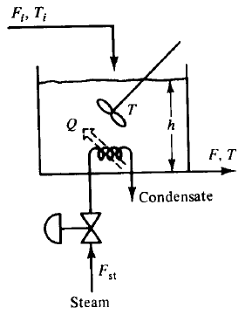
Requirements from a control
1. Suppressing External Disturbances
Objectives: Achieve Set-point
T = T_{s}
h = h_{s}
After reaching steady-state from start-up, disturbances in F_{i} and T_{i} cause changes in F, T.
How to achieve the objective?
Stirred Tank Heater (Stephanopoulos, 1984)

Slide 6
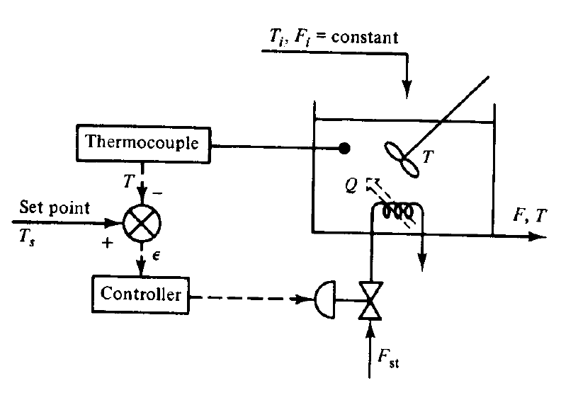
Controlling T in a Stirred Tank Heater
measure T
compare measured T with T_{s}
Compute error:
e = T_{s} - T
e > 0; T_{s} > T (increase F_{st})
e < 0; T_{s} < T (reduce F_{st})
Feedback Control in a Stirred Tank Heater
(Stephanopoulos, 1984)

Slide 7
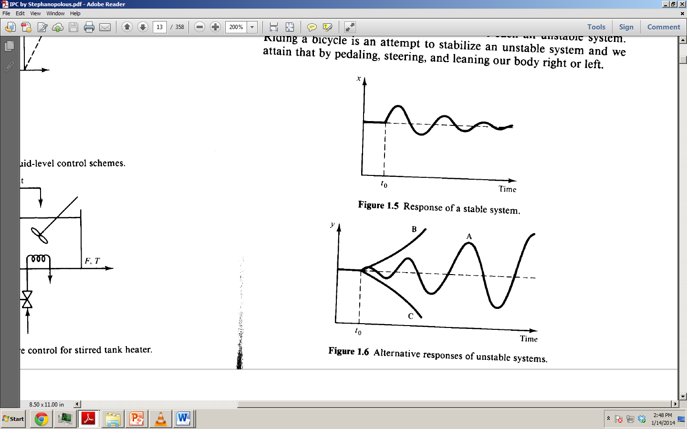
Requirements from a control
2. Ensure the Stability of a Process
x (or y) can be T, C_{A}, F; x is disturbed at t₀
x returns to steady-state without an intervention in a self-regulating process
y never returns to steady-state in three different unstable processes (A, B, C)

Slide 8
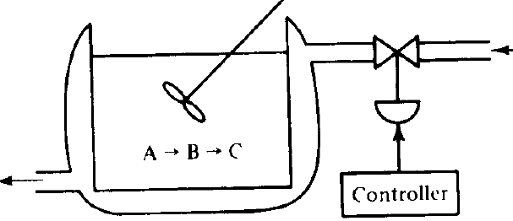
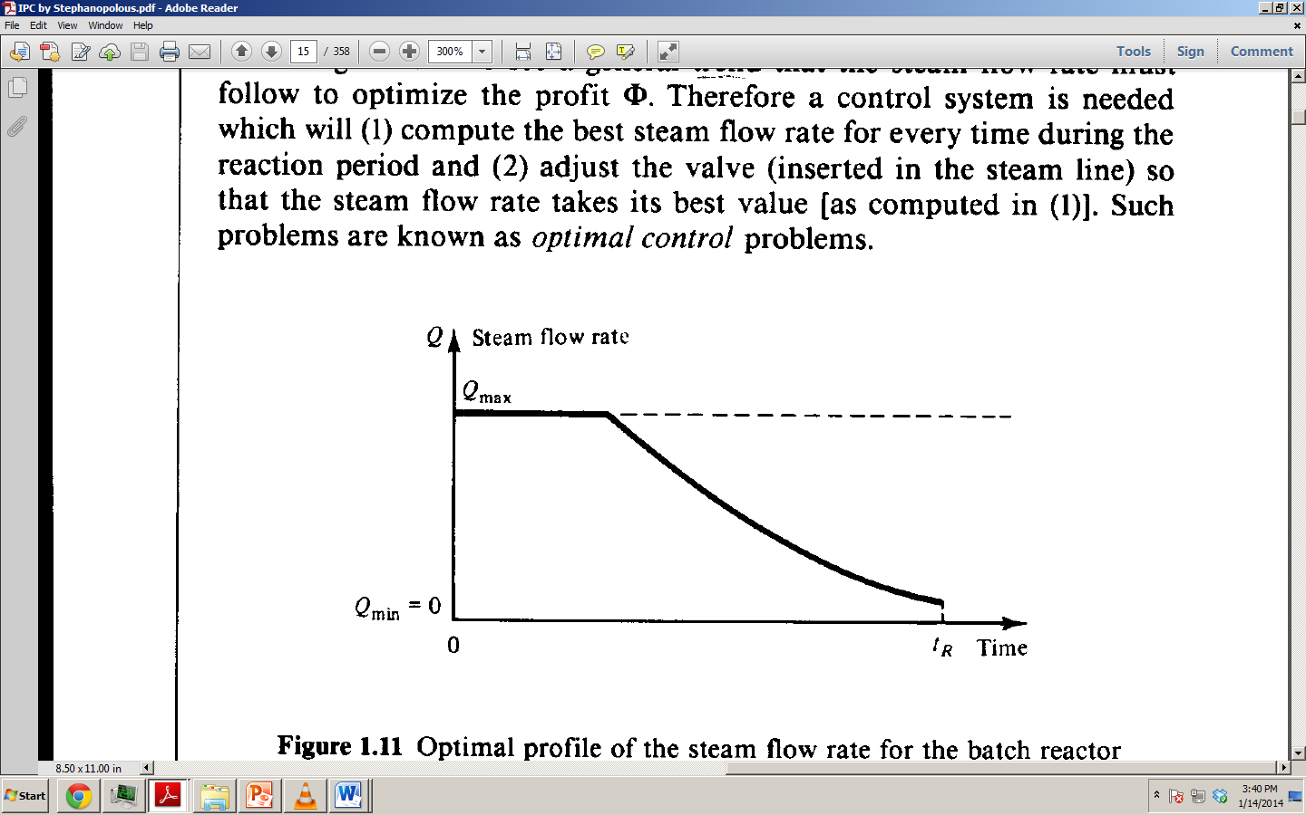
Requirements from a control
3. Optimization of the Performance of a Batch Reactor
Optimization is a major requirement to achieve maximum profit.
A (feed) → B (desired) → C (undesired); endothermic reaction
Scenarios:
Q(t) is given the largest value during entire T_{R} to favor A → B
Q(t) is given the smallest value during entire T_{R} to suppress B→ C
Optimization of Q(t) during T_{R}
Steam
Condensate
Economic Objective
Maximize profit =
ʃ₀^{tR} f (A, B, steam) dt

Slide 9
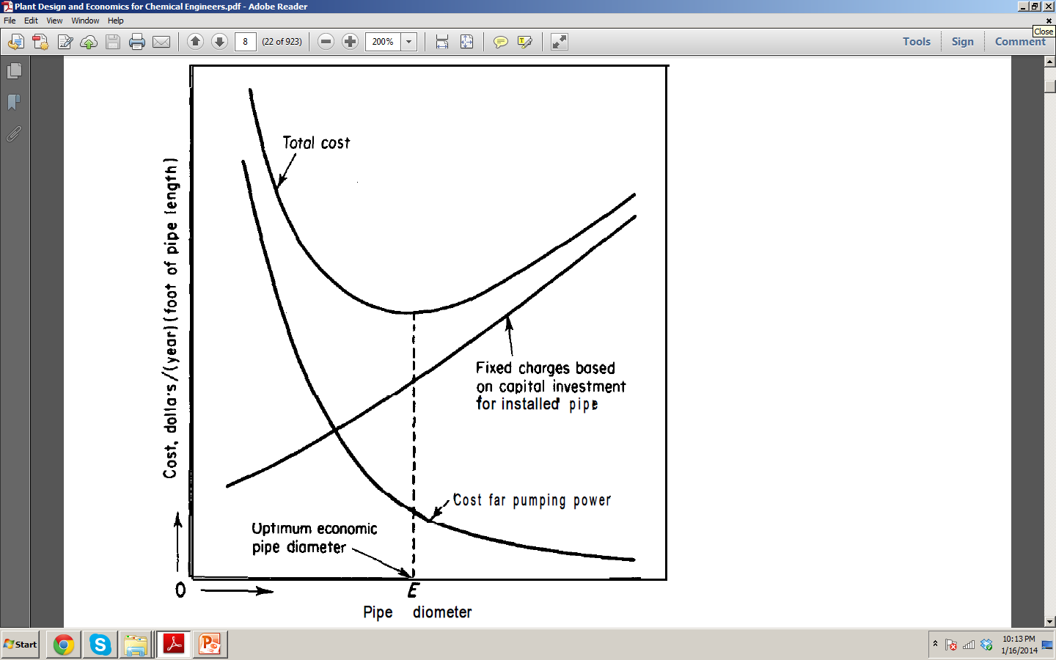
Visualizing ‘Optimization’ in Chemical Plants
Case: Liquid can be pumped between two points by choosing different pipe diameters (with right pumping system). The total cost of transportation includes the pumping (and power) cost and piping cost.
Scenario One:
Pipe with smaller diameters are cheaper but pumping cost increases.
Scenario Two:
Pumping cost is small in a pipe with large diameter but such pipes are expensive.
What is the ‘best’ pipe-pump combination?
Cost / year/ length
Pipe Diameter
Peters and Timmerhaus (1991)

Slide 10
Classification of Variables
Input variables (sometime called as load variables or LV)
Further classified as disturbances and manipulated or control variables)
Output variables
Further classified into measured and unmeasured variables
Often, manipulated variable effects output variable (measured) known as controlled variable
When an output variable is chosen as a manipulated variable, it becomes an input variable.
A manipulated variable is always an input variable.

Slide 11
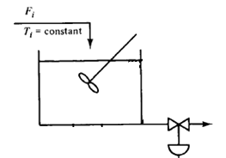
Design Elements in a Control
Define Control Objective: what are the operational objectives of a control system
Select Measurements: what variables must be measured to monitor the performance of a chemical plant
Select Manipulated Variables: what are the manipulated variables to be used to control a chemical process
Select the Control Configuration: information structure for measured and controlled variables. Configurations include feedback control, inferential control, feedforward control
Objective: h = h_{s} (Controlled Variable or CV)
Scenario | Contrd. Variable | Manip. Variable | Input Variable | Output Variable
1 (shown) | h | F | F_{i} | h
2 | h | F_{i} |  | F, h
h A
F

Slide 12
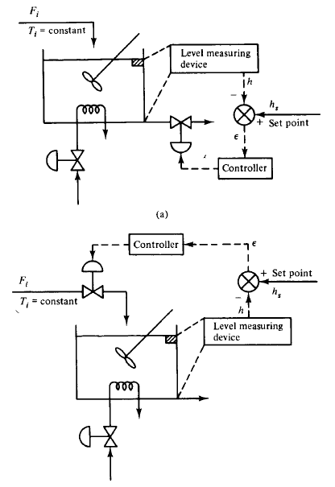
Design Elements in a Control
h A
Control Objective
(a) T = T_{s}
(b) h = h_{s}
F, T
F_{st}
Input variables
F_{i}, F_{st}, T_{i}, (F)
Output variables
F, T, h
h A
F, T
Temperature and level control in a stirred tank heater (Stephanopoulos, 1984)
F_{st}

Slide 13
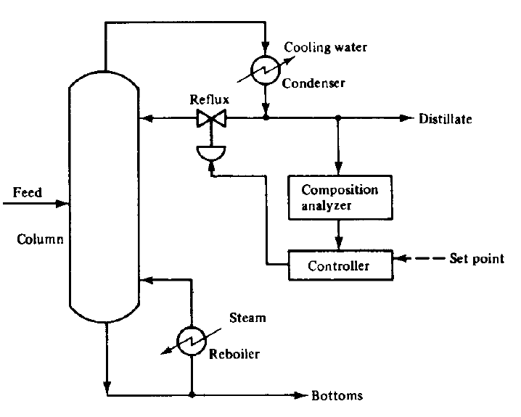
Control Configurations in a Distillation Column
Define Control Objective:
95 % top product
Select Measurements:
composition of Distillate
Select Manipulated variables:
Reflux ratio
Select the Control Configuration: feedback control
(Stephanopoulos, 1984)

Slide 14
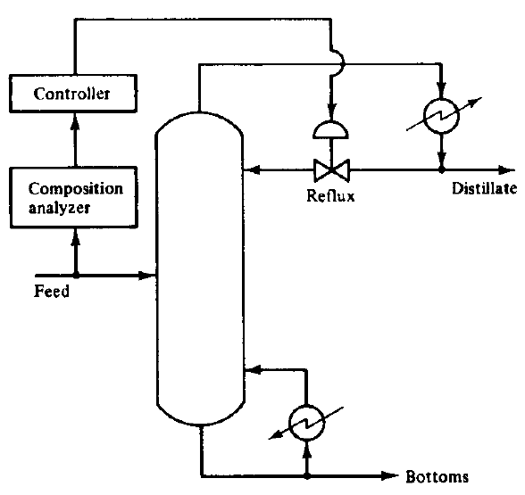
Feedforward Control Configuration in a Distillation Column
Control x_{D}
(Stephanopoulos, 1984)

Slide 15
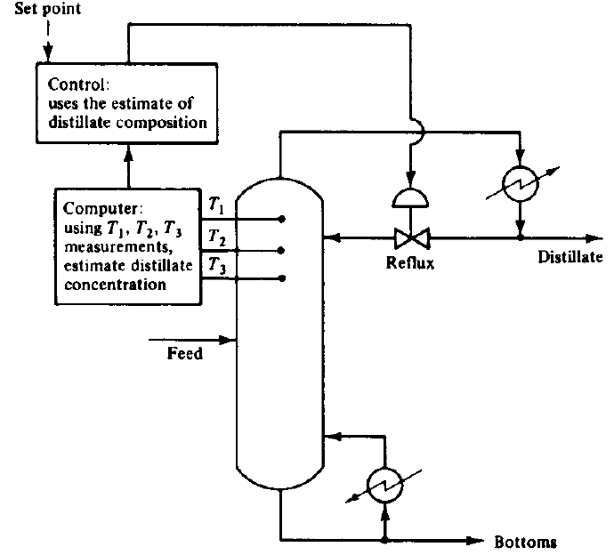
Inferential Control in a Distillation Column
Control Objective: x_{D}
Unmeasured input =
f (secondary measurements)
(Stephanopoulos, 1984)

Slide 16
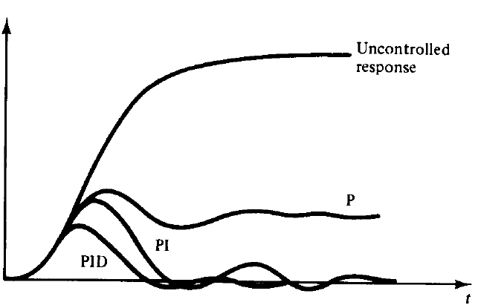


Types of Feedback Controllers
Proportional:
c(t) = K_{c} Є(t) + c_{s}
Proportional-Integral:
$c\left(t\right)=k_{c}Є\left(t\right)+\frac{k_{c}}{τ_{I}}\int_{0}^{t}{Є\left(t\right)dt+c_{s}}$
Proportional-Integral-Derivative:
$c\left(t\right)=k_{c}Є\left(t\right)+\frac{k_{c}}{τ_{I}}\int_{0}^{t}{Є\left(t\right)dt+k_{c}τ_{I }\frac{dЄ}{dt}+c_{s}}$
Nomenclature
actuating output $c\left(t\right)$,
error $Є\left(t\right)$,
gain $k_{c}$,
time constant $τ_{I }$
$Є$(t)
(Stephanopoulos, 1984)

Slide 17
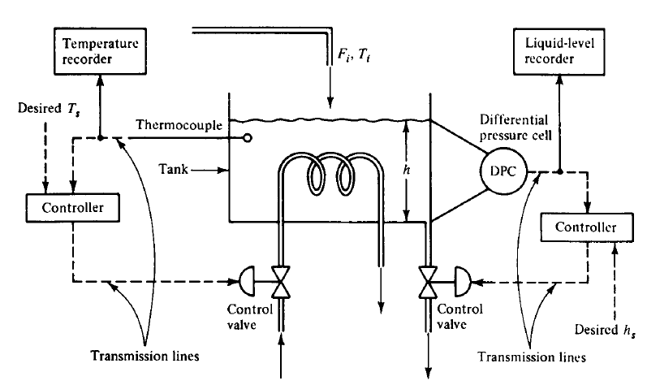
Hardware for a Process Control System
The process (chemical or physical)
Measuring instruments and sensors (inputs, outputs)
what are the sensors for measuring T, P, F, h, x, etc?
Transducers (converts measurements to current/ voltage)
Transmission lines/ amplifier
The controller (intelligence)
The final control element
Recording/ display
elements
Recall Process
Instrumentation
(Stephanopoulos, 1984)

Slide 18
Week 1
Weekly Take-Home Assignment
Introduction to Process Dynamics and Control
Chapter 1-3, Pages 1-41 (Stephanopoulos, 1984)
Problems for Part I (page 36-41) PI.1 to 1.10 of Stephanopoulos (1984)
Submit before Friday
Curriculum and handouts are posted at:
http://faculty.waheed-afzal1.pu.edu.pk/

